Slide 1
BELGIUM VISIT

Slide 2
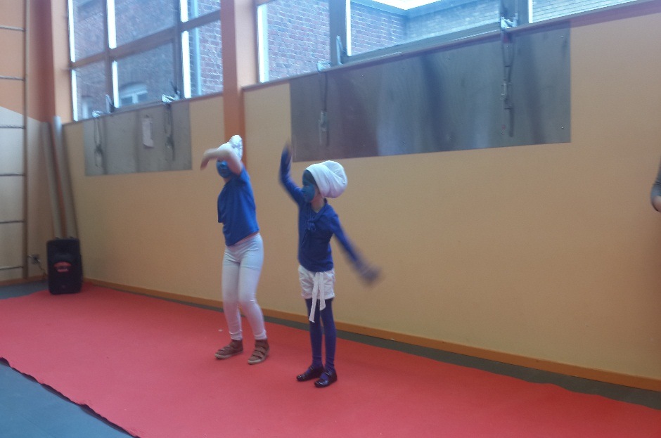
THE STUDENTS İN DE SAM WELCOMED US WITH GREAT SHOWS…

Slide 3
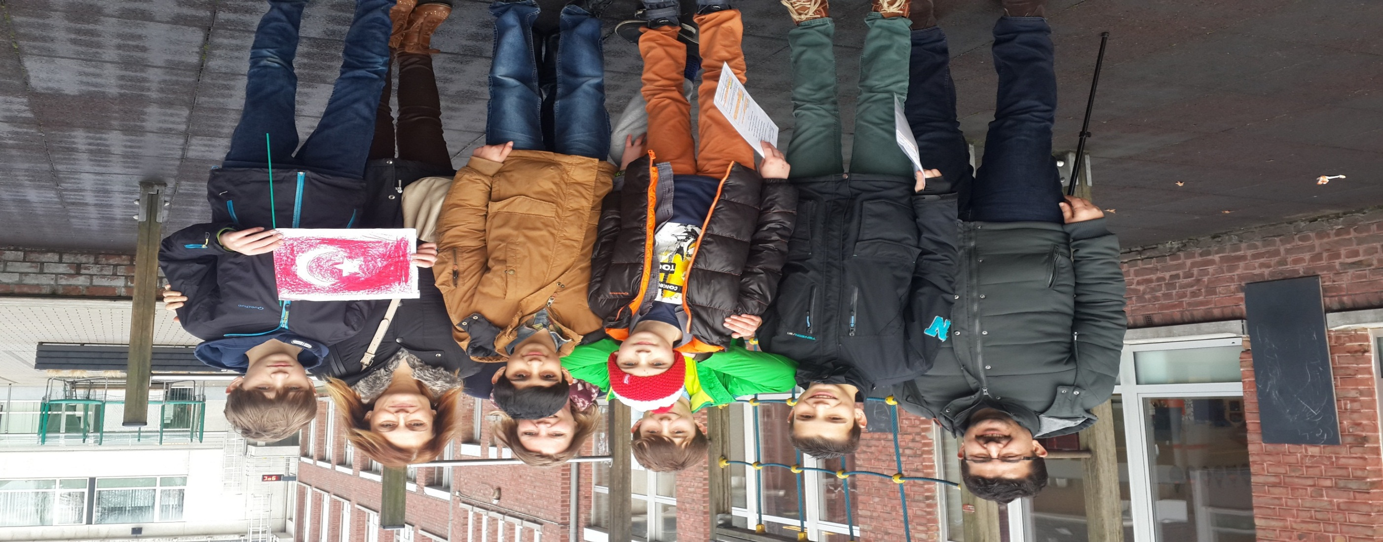
The students guıde us while we were looking around the school.

Slide 4
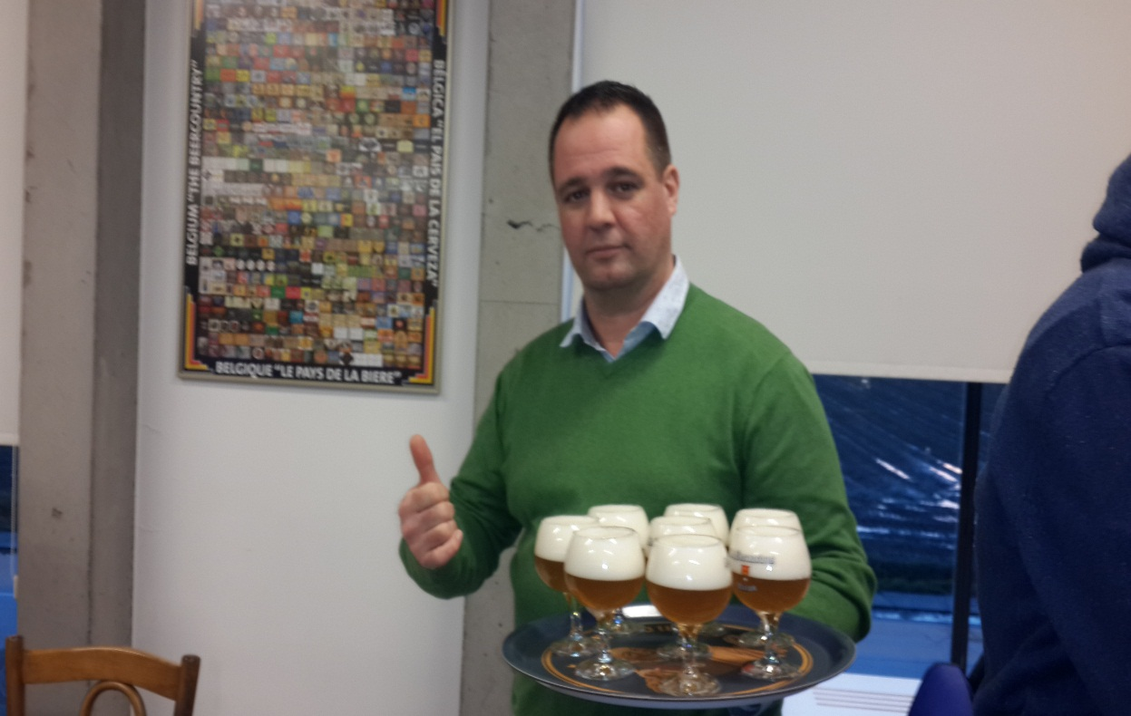
DINNNERS İN THE SCHOOL CANTEEN..HMM..YUMMY YUMMY

Slide 5
WE VISITED DIFFERENT SCHOOLS…

Slide 6
OUR STUDENTS SHOWED THEIR TALENTS..

Slide 7
WE HAD TOURS TO THE OTHER CITIES OF BELGIUM..THEY WERE AMAZİNG…..

Slide 8
